Slide 1
These aren’t the objects you’re looking for
Chris Neill

Slide 2
Accessing I/O paths typically require a name
Name resolution determines I/O path
Overview
Results receive too much trust
Many opportunities for redirection

Slide 3
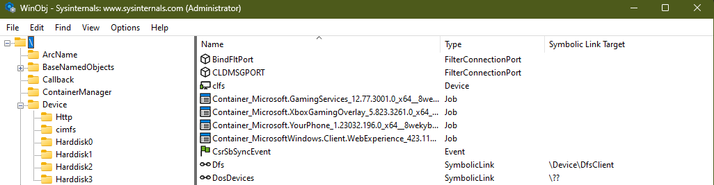
Object Namespace

Slide 4
Step 1:
Path
Normalization
Example:
C:\foo\bar.bz
Normalized by ntdll!RtlDosPathNameToNtPathName_U
\??\C:\foo\bar.baz
Identifies name in absolute terms for the object manager
Kernel opens expected to already be normalized
Project Zero 2016 extensive write-up
https://googleprojectzero.blogspot.com/2016/02/the-definitive-guide-on-win32-to-nt.html

Slide 5
Step 2:
Object Name Lookup
Path:
\??\C:\foo\bar.bz
Passed to Object Manager
\?? Doesn’t exist as an object or symbolic link
\?? Starts name lookup in current session (\Sessions\<Number>\DosDevices)
\GLOBAL?? Lookup if no matching name in session
name space
Object Manager identifies directory object
- Looks for object with matching name in the directory
- Resolves symbolic links

Slide 6
Step 3:
Object Identified
Path:
\Device\HarddiskVolume1\foo\bar.baz
If path identifies named object only
(ex: \Device\PhysicalMemory)
Skip to Step 5
Otherwise object specific parse routine invoked
- Set at object type creation time via nt!ObCreateObjectType
- For devices, nt!lopParseDevice
- Name substring that does NOT identify object is passed along
- As is the object itself
- If reparse status received, repeat this step

Slide 7
Step 4:
Object Access Parse
Path:
\foo\bar.baz
Security access check for the object
For devices, identify device stack for open submission
- Submit open (FASTIO/IRP) to device stack
- Receiving devices determine access allowed

Slide 8
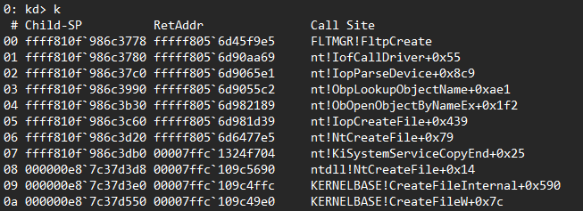
Call Stack

Slide 9
Step 5:
Handle Creation
Object Manager creates handle table entry for object:
Entry contains object and access rights information
Insert handle table entry into appropriate handle table
- Generally, the handle table for the current process
- Kernel handles inserted into the System process handle table
- Global system handle table contains entries for process/thread objects
Handle returned to requestor
Created through nt!ExCreateHandle

Slide 10
What is a “device stack”?
Doubly-linked, NULL terminated list of DEVICE_OBJECT structures
Linked through:
DEVICE_OBJECT.AttachedDevice
DEVICE_OBJECT.DeviceObjectExtension->AttachedTo
Integral to support of the Windows layered I/O model
Typically contains one or more named objects
User-mode accesses through HANDLEs to FILE_OBJECTs

Slide 11
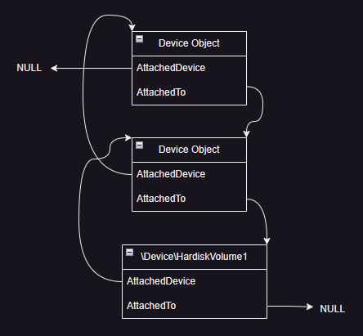





Slide 12
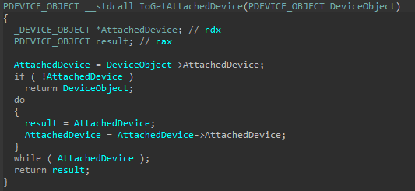

Slide 13
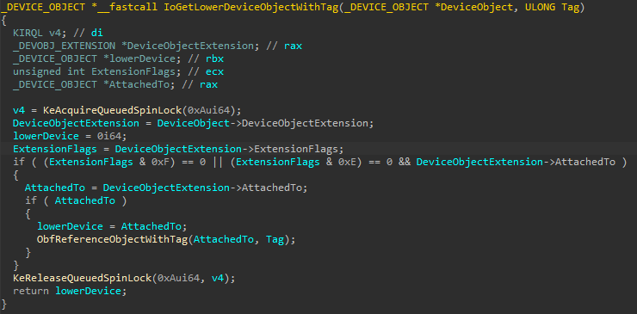

Slide 14
Validating Driver Objects
Ensure driver object refers to a file on the file system
Digital signature of file is valid
Driver object section matches the file system content
Function pointers refer to driver section or ntoskrnl
Enumerate devices backed by each driver
GOAL: ensure loaded drives are “trustworthy”

Slide 15
Common Object Validations
Validate driver objects found in \Drivers namespace directory
Enumerate devices backed by each driver
Validate device objects found in object directory or driver object list
Validate file handles in a process (maybe, not usually)

Slide 16
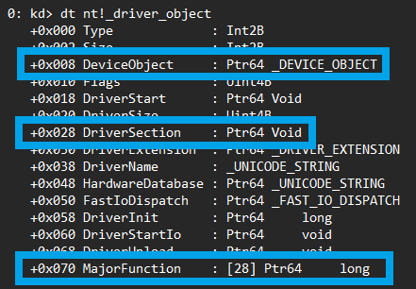

Slide 17
Validating Device Objects
Walk device stack
Validate each device object references a valid driver object
GOAL: ensure all devices are backed by a “trustworthy” driver

Slide 18
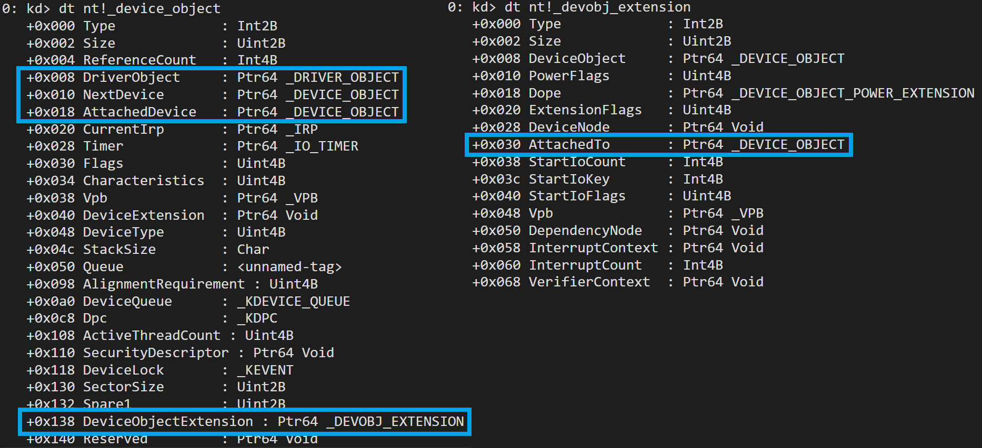

Slide 19
Validating File Handles
Use handle to locate device stack
nt!NtQuerySystemInformation(SystemHandleInformation)
nt!NtQuerySystemInformation(SystemExtendedHandleInformation)
Run device object validation
Why?
Broadens search to include device stacks not accessible
by a name
GOAL: ensure I/O path integrity through “trusted” or
“checkable” code

Slide 20
Validation Oversights
Assume the name refers to the intended object
Difficult to cross-check object type – sections all look similar
Devices can be validated against the expected driver object
But what is expected, and in what versions?
Assume a device stack always contains at least one named object
Usually true, otherwise the Object Manager
can't find the device
Not true for file system-mounted volumes

Slide 21
Object Directory Manipulation
Names assigned to objects only when they're created
No duplicate names allowed
Object destruction removes names
Object MUST be unlinked from the directory before destruction
Opening an object after it's destroyed would be bad
Names can be swapped
nt!NtSetSystemInformation(SystemHotpatchInformation)
Or removed from the directory without object destruction

Slide 22
Name Removal
ObMakeTemporaryObject() can remove names
Via ObpDeleteNameCheck()
Exported, but not documented
Object must not have open handles
Properly locks the object database before removal
Will decrement the object reference count
Also clears the permanent object flag
But most objects aren't permanent
Non-HANDLE references remain valid

Slide 23
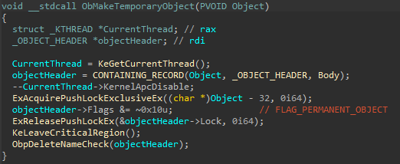
ObMakeTemporaryObject

Slide 24
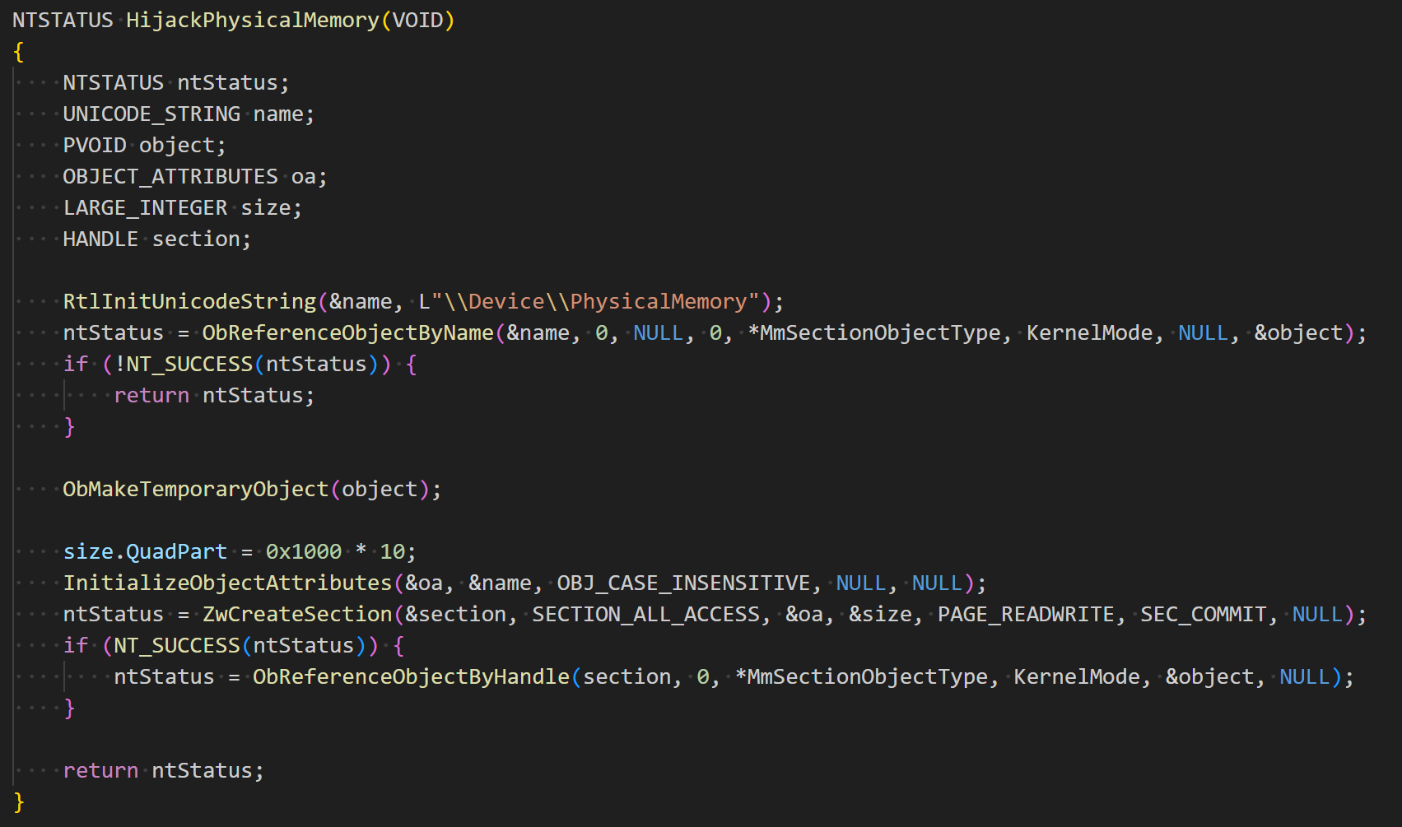

Slide 25
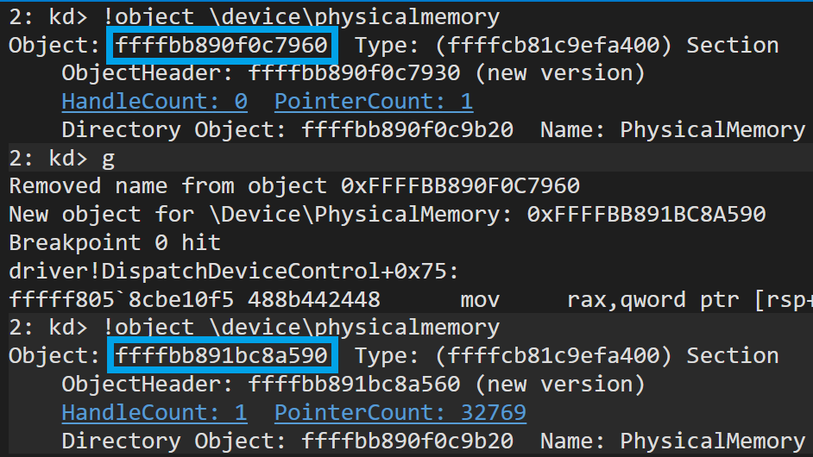

Slide 26
Example used \Device\PhysicalMemory
Common object used to verify system integrity
Anti-cheats use it to look for drivers that might be used to load cheat software
Some security tools use it as a memory cross-validation method
Memory forensics tools will capture contents for offline analysis
The content is whatever I decide
As long as I get to the object first

Slide 27
Device Stack Identification
Associating a file object with a device stack is not straightforward
Mounting a file system creates complex device stacks
Volume Parameter Block (VPB) ties volume stack to file system stack
Created for all disk/tape/cdrom devices
File system stack typically has no named devices

Slide 28
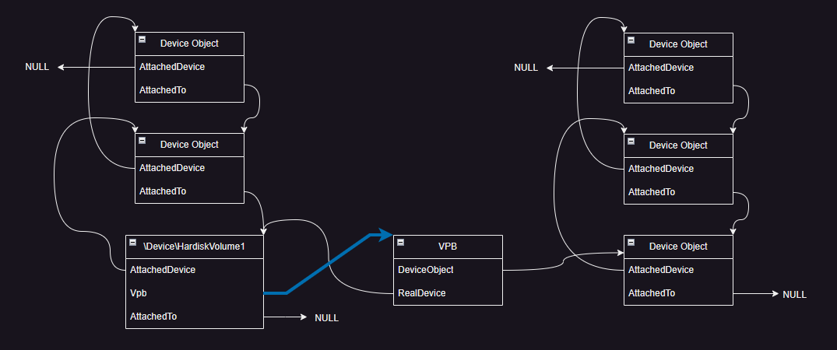
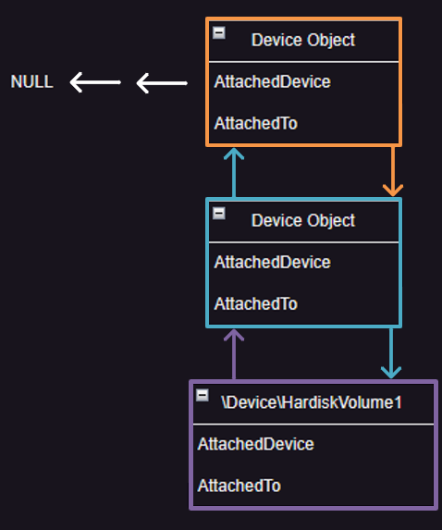
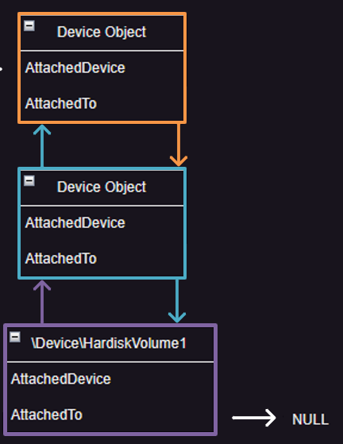
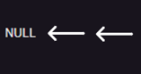





Slide 29
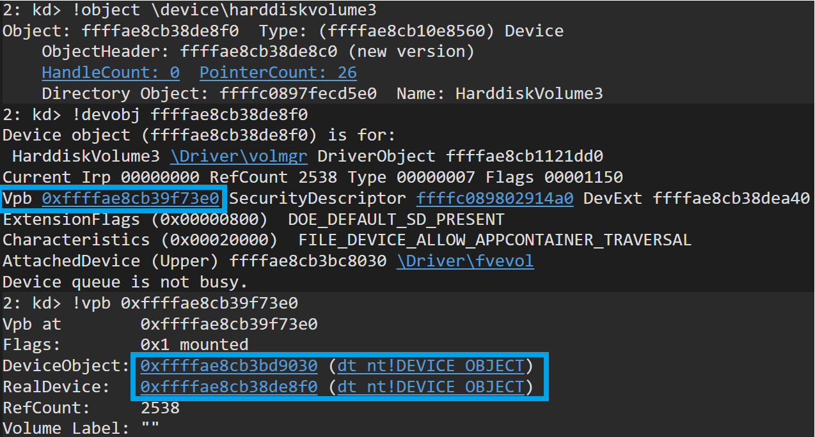

Slide 30
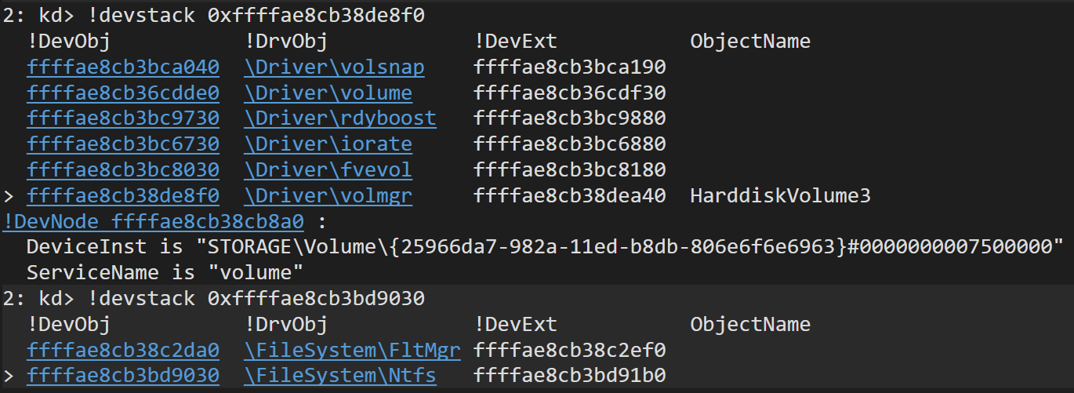

Slide 31
Volume Parameter Block
Always checked for non-NULL by nt!IopParseDevice
Device type doesn't matter!
Used to find device stack for I/O submission
Copied to FILE_OBJECT from DEVICE_OBJECT during open
Accessed during all subsequent operations by I/O manager
e.g. read/write

Slide 32
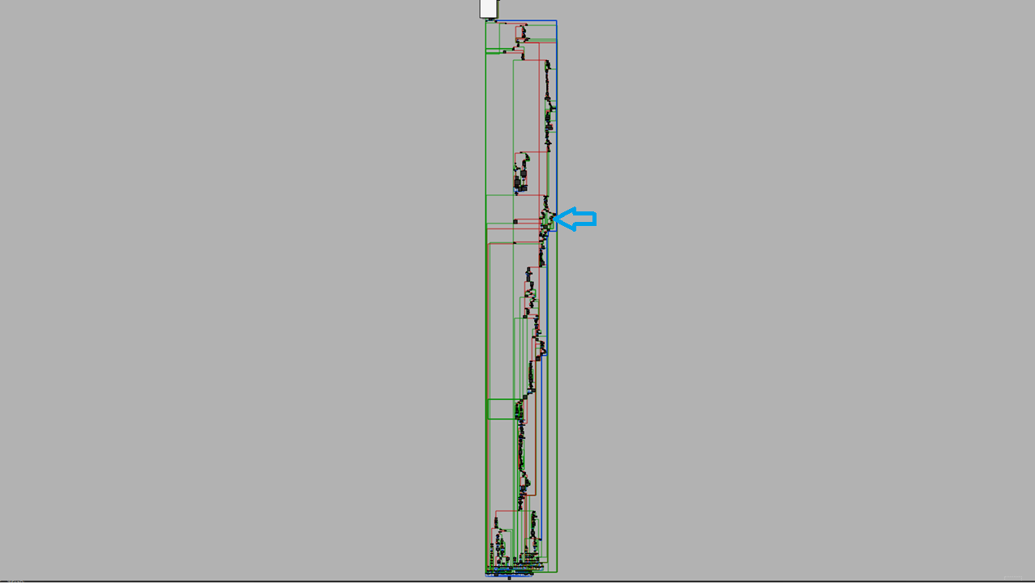

Slide 33
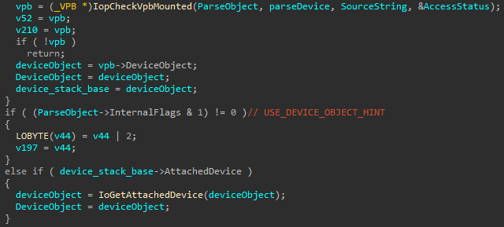
IopParseDevice

Slide 34
Device Stack Redirection
VPB structure is fully documented
https://learn.microsoft.com/en-us/windows-hardware/drivers/ddi/wdm/ns-wdm-_vpb
Required for 3rd party file system support
Allocate your own
Assign to the named device object you want
Just don't free the memory
Follow file system dismount process
Small memory leak, but the system will be stable
VPB infrequently traversed by security products

Slide 35
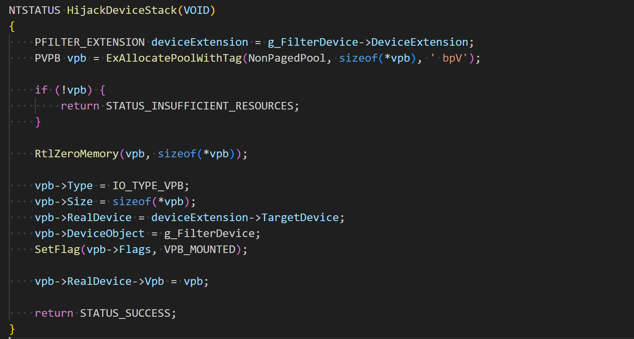

Slide 36
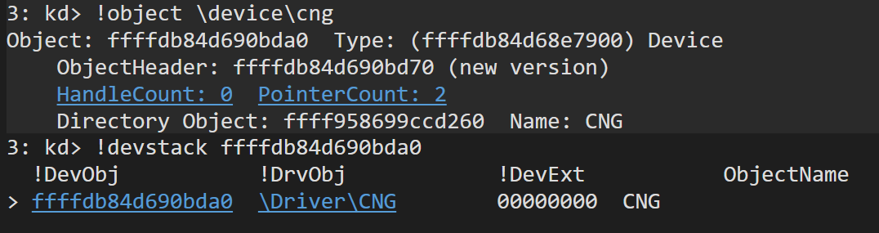

Slide 37
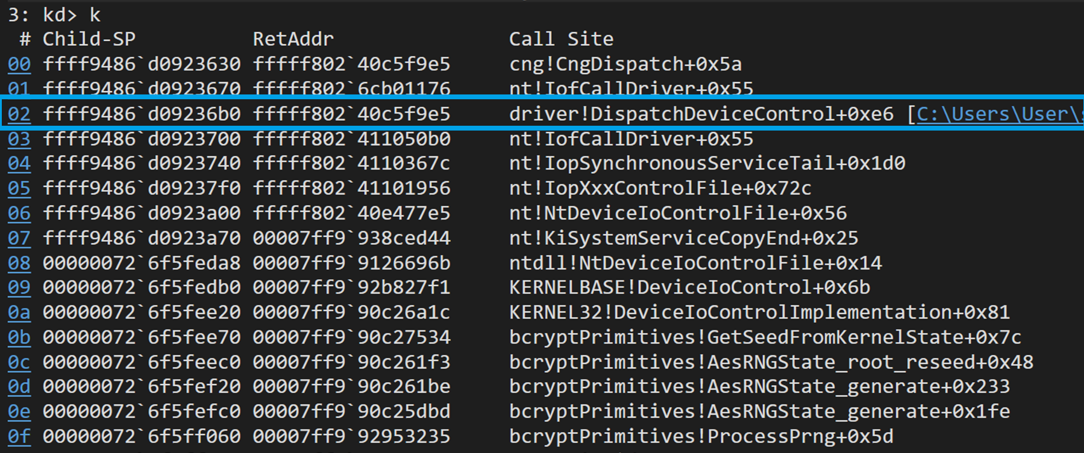

Slide 38
And we’re done!
Example code and slides at:
github.com/chris-neill/txcyber2023

